Slide 1
Opportunities for Real-Time Collaboration and Risk Reduction in Emergency Management with OGC GeoPose
Mikel Salazar Ph.D.
Senior Researcher and Project Manager at IFE, Norway
contact@mikelsalazar.com

Slide 2
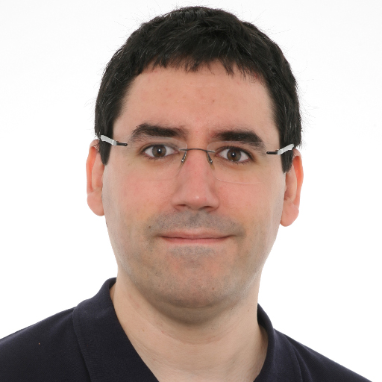

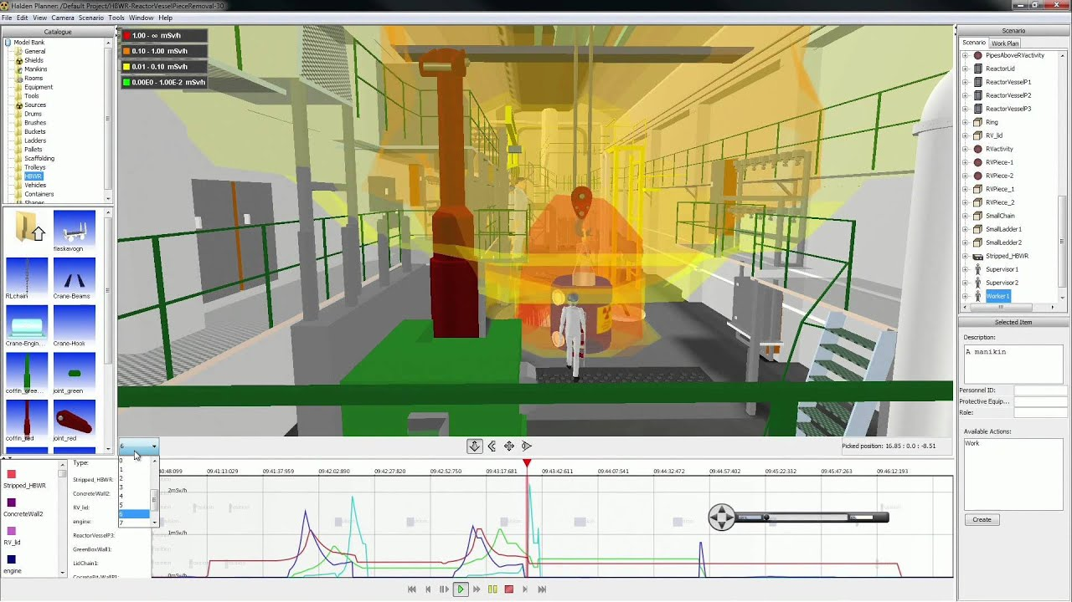
Speaker Information
Mikel Salazar, Ph.D.
IFE, Halden, Norway
HCI Researcher that participates in the creation of several standards to enable users to collaborate to share complex 3D and geospatial data across cultural and technological barriers.
In the VR department, we have experience building tools to manage emergencies in the nuclear sector, helping users to avoid invisible hazards by using advanced visualization and navigation systems.
Notes:
Hello Everyone, I am Mikel Salazar. A researcher at IFE-Halden, in Norway that participates in the creation of several standards to enable users to collaborate to share complex 3D and geospatial data across cultural and technological barriers.
In the VR department, we have experience building tools to manage emergencies in the nuclear sector, helping operators to avoid invisible hazards by using advanced visualization and navigation systems.
However, to apply this experience to bigger facilities, Euclidean geometry is no longer enough… and that is why we are collaborating in the development of a new geospatial standard: GeoPose.

Slide 3

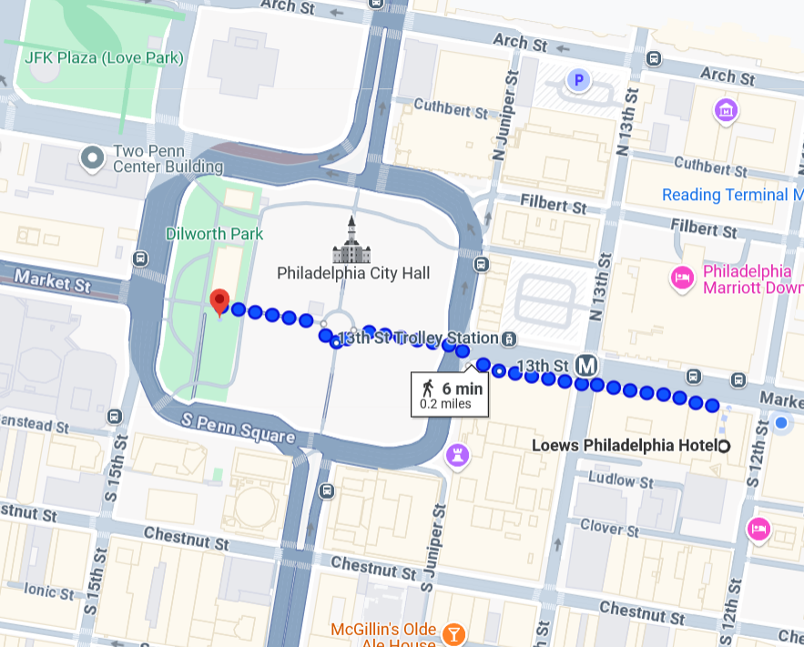
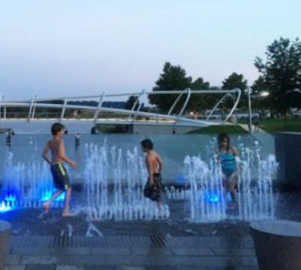
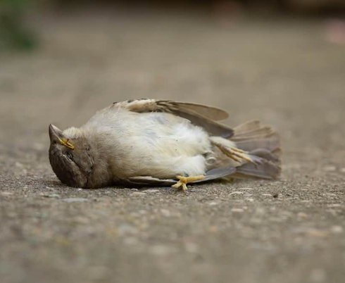
It's a (Too) Beautiful Day Outside…
Notes:
It is a beautiful day outside. Too beautiful, in fact. (Over 100ºF outside
Birds are not singing, flowers are not blowing.
Fortunately, we can use geospatial information to find a fountain or a bar (or even to guide others to bring us the beverages).
In the not so distant future, things will not be so rosie.

Slide 4
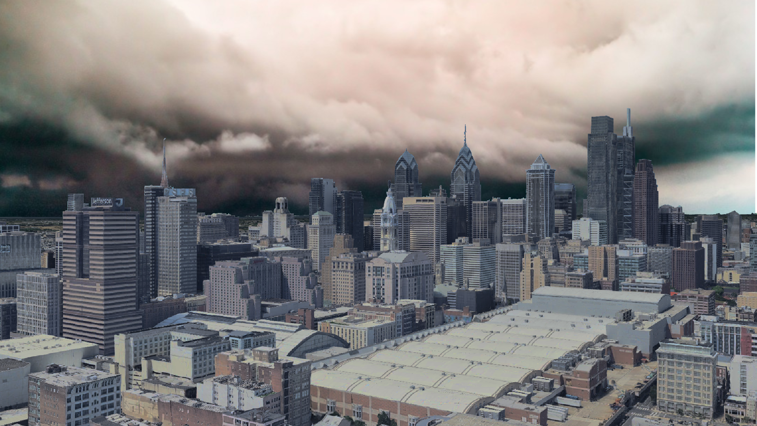
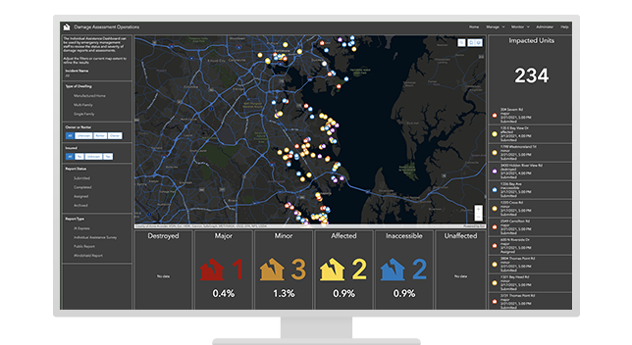
Disaster Strikes!
New Jersey
3 Kms (2 miles)
to the East
You are here
30 ms (100 feet)
above sea level
Limerick NPP
60 Kms (35 miles)
to the Northwest
Notes:
A hurricane is looming over the horizon (similar to the to Hurricane Ida, that in 2021 generated a tornado outbreak).
I don't want to alarm you, but... we are 30 meters (100 feet) above sea level, and we are 60Km (35 miles) away from a nuclear plant. And above all else, New Jersey is next to us. New Jersey!
Emergency management systems operate on a 2D cenital view, so all the 36 floors of this building appear like a small area in their views of the world.
Oh... and the FEMA cuts have given local teams less time and resources to deal for this situation. So... Good luck!

Slide 5


(OGC) GeoPose to the Rescue!
Notes:
Fortunately, GeoPose is here to save the day! (Heroic music starts playing... but no superhero appears. Misdirection.)
Oh, it is because has been already here for weeks, telling people where the hazards might be, guiding them to safety (when there are no problems of communication).
And now is enabling emergency responders to reach the areas and people that need their help.
Because, as Im sure you already know, emergency management is not just the response, it is also prevention, preparedness and recovery. And Geospatial information plays and important part in building resilience to disasters.
But static entities are not enough, that is why we need a way to model dynamic entities .

Slide 6
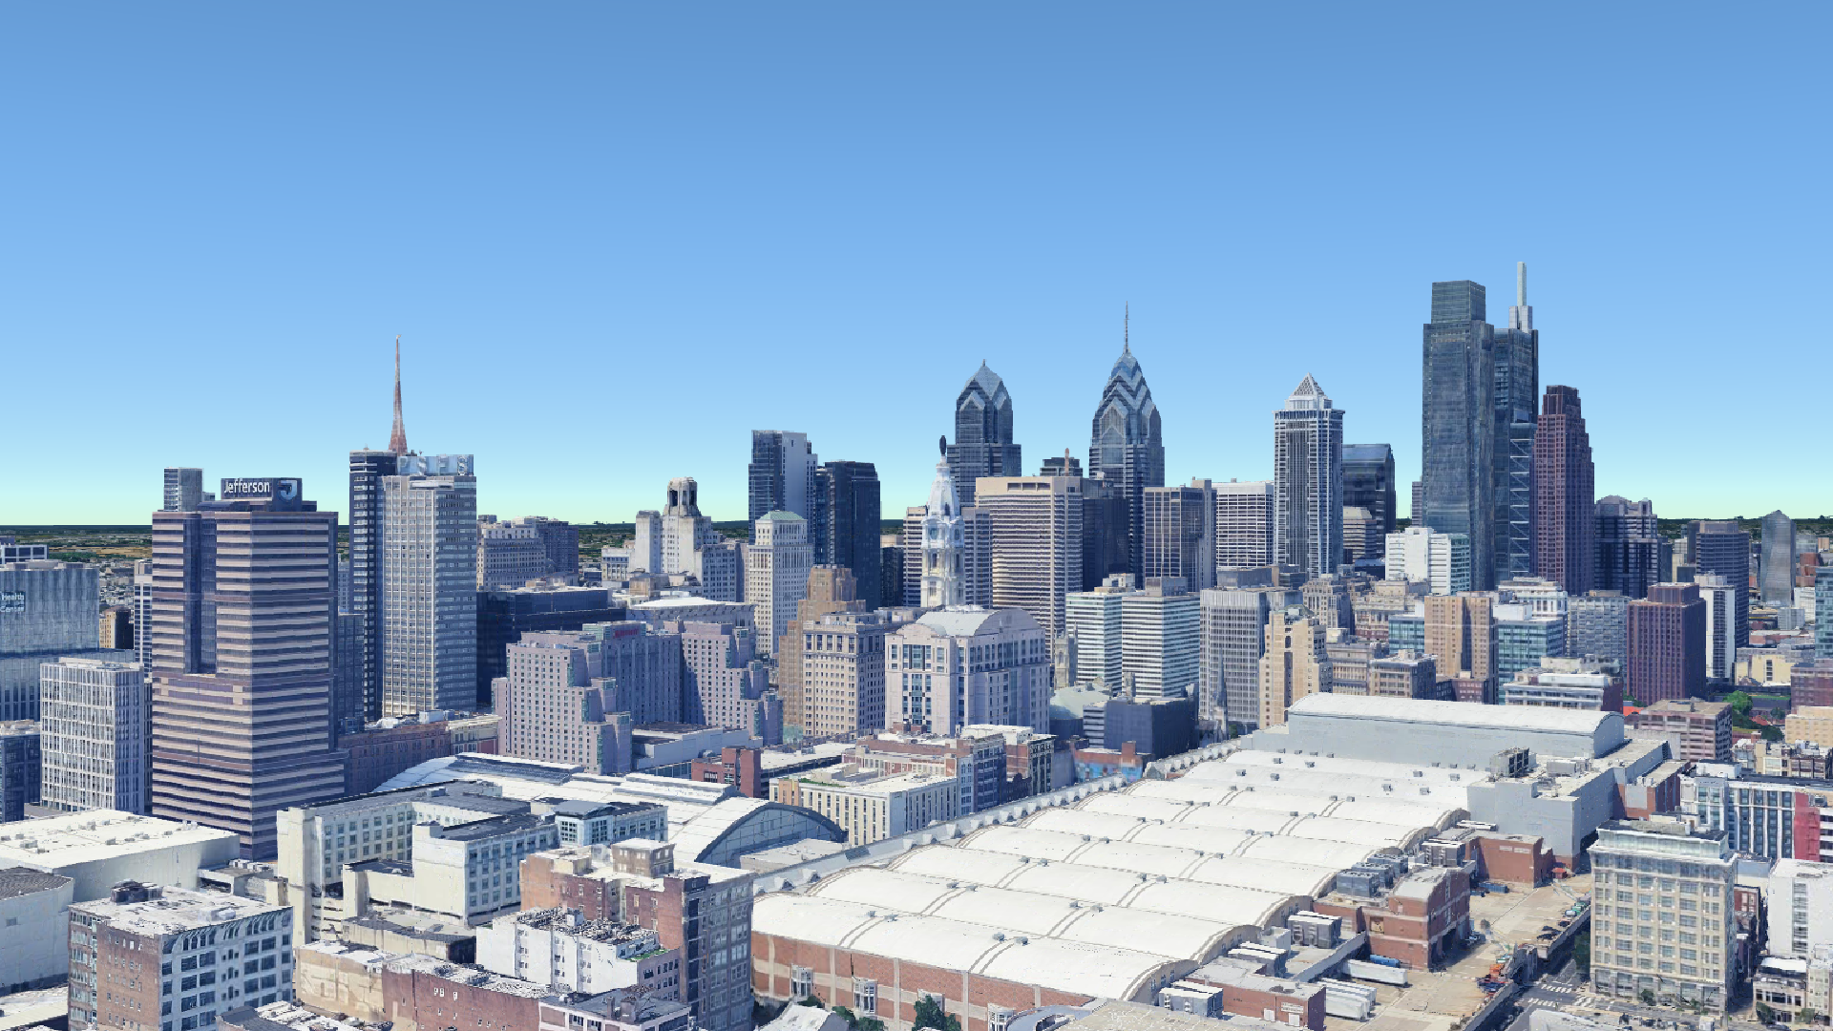
What is (OGC) GeoPose?
GeoPose is a standard issued by the Open Geospatial Consortium (OGC) that aims to define interoperable encodings to facilitate the communication of the position and orientation of (real or virtual) entities, relative to a geographical frame of reference.
let cameraGeoPose = {
location: { // Position on the WGS84 Ellipsoid
lat: 39.956, // Latitude (in degrees)
lon: -75.154, // Longitude (in degrees)
h: 100 // Height-over-Ellipsoid (in meters)
},
angles: { // Rotation relative to geoposition
yaw: 205, // Vertical axis (in degrees)
pitch: 0, // Lateral axis (in degrees)
roll: 0 // Forward axis (in degrees)
}
}
Notes:
Aware of this situation, the Open Geospatial Consortium created a working group focused on defining a standard that was able to encode the position and orientation of an entity in geographical space: The result was OGC GeoPose 1.0 and there are already several implementations..
If you are used to work with 3D engines, you can imagine it as a transform, without a scale factor and additional optional information (time, uncertainty, etc.). It is normally encoded as a JSON object, but other encodings are available.
The idea is that, even if you do not mention anything else, you can communicate that there is "something" there in an interoperable way, enabling the real-time collaboration between heterogeneous agents.

Slide 7
How can GeoPoses be used?
(Geo)Posing: Providing a GeoPose to any entity enables its easy integration into a 3D map, allowing third parties to better understand the situation.
(Geo)Tracking: By constantly updating a GeoPose (giving it a timestamp) it is possible to follow the movement of dynamic entities and create their (GeoPose-based) paths .
(Geo)Navigation: By projecting these paths into the future it is possible to not merely react, but plan ahead and define paths to reach –or avoid– the different entities.
Notes:
Being something so fundamental, GeoPose has innumerable applications in many domains, but in the context of emergency management, there are many important things you can use it for:
(Geo)Posing: Adding a GeoPose to a photo or video enables emergency responders to incorporate it into their 3D maps, allowing normal people to provide better information than just verbal descriptions
(Geo)Tracking: Using it to indicate the current position of entities that need to be tracked (individual agents, hazards, etc).
(Geo)Pathing: Establishing a path with an array of GeoPoses to guide an agent to a particular location or communicate a intended path to avoid collisions. The same technoque can also be used to provide a like hurricanes or wildfires a possible trajectory, so that agents can get out of their way.
There are limits to what a GeoPose can do by itself (e.g. we can not add GeoPoses to tsunamis or toxic clouds), but they can be used to pose the simulation result that use euclidean coordinates.

Slide 8
Saving the day... one GeoPose at a time
Notes:
Thanks to different agents collaborating together, the city is safe again, and the recovery operations can commence... also using GeoPose, of course!
By incorporating GeoPose into Cesium, the latter stops being just a visualization tool and becomes a collaborative 3D editor in which many agents can communicate complex information. And that can have many applications.

Slide 9
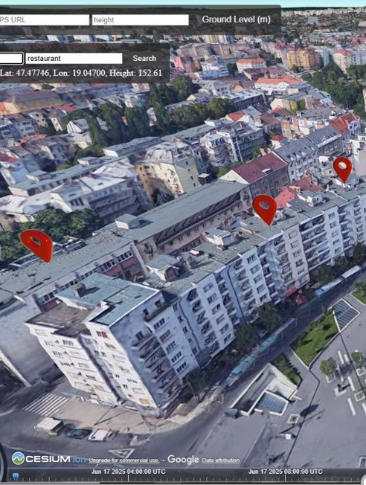
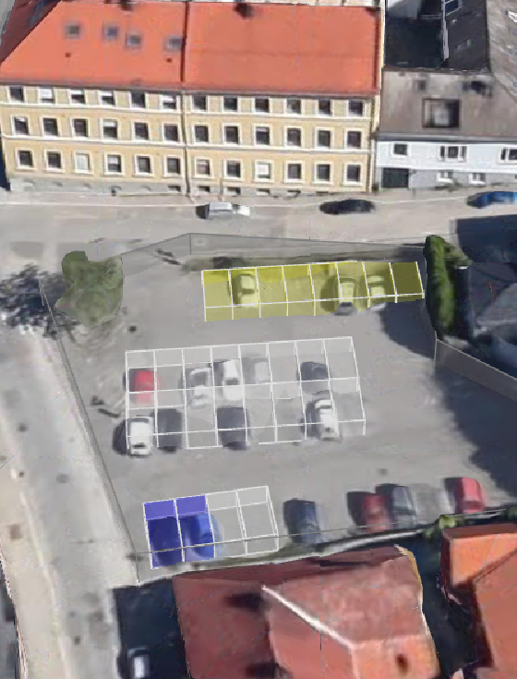
Next Standards (Using GeoPose and CesiumJS)
?
Visual Positioning System (OpenVPS)
Reality Modelling Language (RML)
(Insert your standard here)
Notes:
One important thing to realize is that OGC GeoPose is something that can be used inside other standards to make them even better.
Right now, we are working on a open-source Visual Positioning System that enables users to get their GeoPose using images captured from their camera. A solution that works both outside, and... importantly, indoors, where the inability to work with GPS has limited the application of these technologies
I myself I am working on a new description language called Reality Modelling Language (RML) to describe both physical and virtual elements in a spatial way that facilitates the creation of XR experiences

Slide 10
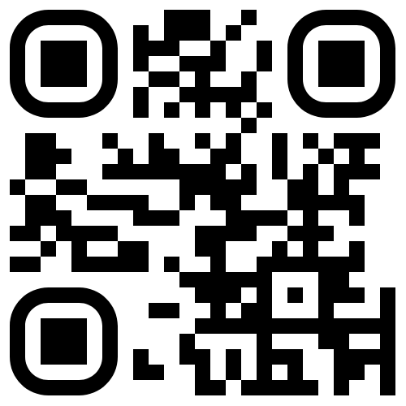
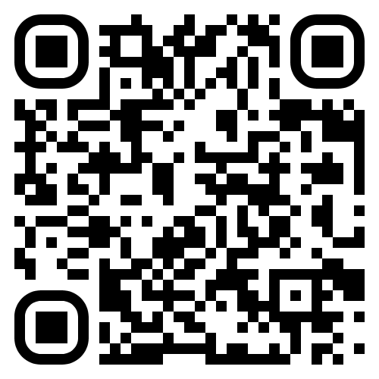
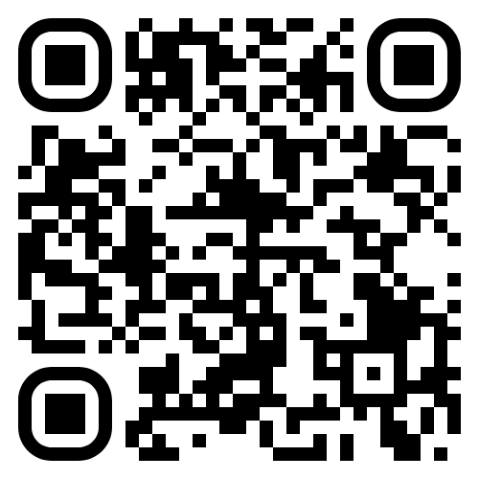
Help Us GeoPose the Future
GeoPose Website
https://geopose.org
OGC Standards Site
https://www.ogc.org/standards/geopose/
Cesium GeoPose
https://github.com/MikelSalazar/GeoPoseCesium

Slide 11
Abstract
When emergencies unfold, threatening lives or urban assets, many different services respond, and coordination is essential. However, many emergency management systems operate with incompatible geospatial data formats, which introduces delays and increases risks (e.g., collisions with drones, invalid evacuation routes, etc.). Against this background, in this presentation, we present the OGC GeoPose conceptual model and demonstrate how its implementation on top of the Cesium platform can improve cooperation between different agencies and, even, prevent accidents.
To illustrate the collaboration opportunities this standard enables, we will also show example use cases where GeoPoses are exchanged to communicate the real-time position and orientation of all types of entities (from vehicles or drones to wildfires and tsunamis) and to define their intended paths (allowing other agents to plan accordingly and avoid collisions).

Slide 12
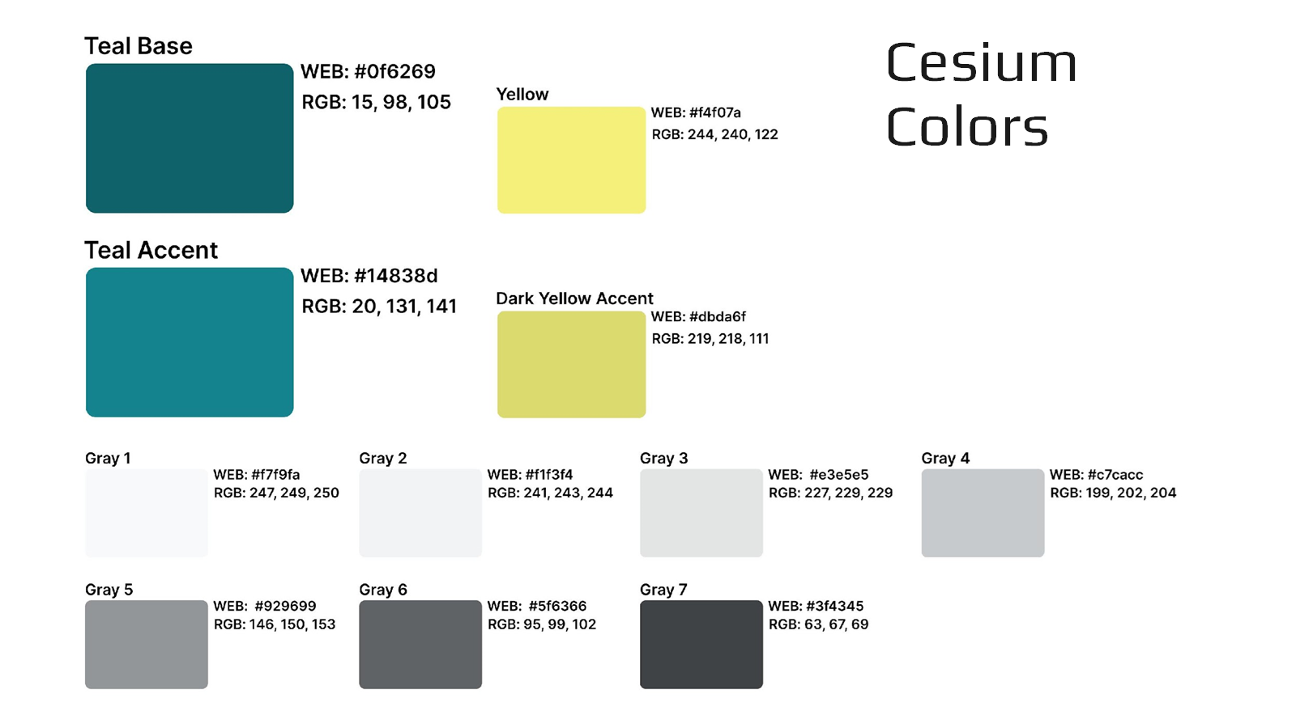
Cesium Brand Elements

Slide 13
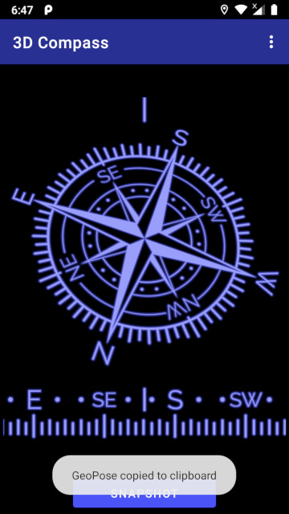
Notes
Resilience, Prevention, Mitigation, Preparedness, Response
https://awayteam.co.uk/products/3dcompass/about

